Slide 1
Review on Multimodal data fusion approaches

Slide 2
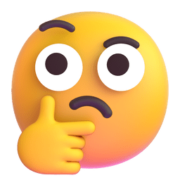
Multimodal Data Fusion
Every imaging modality provides unique, filtered and interrelated information of brain’s structural and functional organization.
Combining modalities can help to provide a more complete understanding of the human brain and its disorder as compared to unimodal studies.
Utilizing multiple modality can leverage the joint or complementary information between them. Thus increase model performance.
This is true not only for neuroimaging data but also for other domains.
But….

Slide 3
Multimodal Data Fusion
Huge amounts of data with characteristics of high volume, high variety, high velocity, and high veracity are generated.
These data, referred to multimodal big data, contain abundant intermodality and cross-modality information
Pose vast challenges on traditional data fusion methods.
Going to present deep learning models to fuse these multimodal big data.
Specifically, representative architectures that are widely used are summarized as fundamental to the understanding of multimodal deep learning
Notes:
With the wide deployments of heterogeneous networks….

Slide 4
Dimitri GM. A Short Survey on Deep Learning for Multimodal Integration: Applications, Future Perspectives and Challenges. Computers. 2022; 11(11):163. https://doi.org/10.3390/computers11110163
Jing Gao, Peng Li, Zhikui Chen, Jianing Zhang; A Survey on Deep Learning for Multimodal Data Fusion. Neural Comput 2020; 32 (5): 829–864. doi: https://doi.org/10.1162/neco_a_01273
Girdhar, R., El-Nouby, A., Liu, Z., Singh, M., Alwala, K.V., Joulin, A., & Misra, I. (2023). ImageBind: One Embedding Space To Bind Them All. ArXiv, abs/2305.05665.
Notes:
The goal of this paper is to provide an overview and survey of DL-based approaches for multi-modal integration.

Slide 5
Dimitri GM. A Short Survey on Deep Learning for Multimodal Integration: Applications, Future Perspectives and Challenges. Computers. 2022; 11(11):163. https://doi.org/10.3390/computers11110163
Notes:
The goal of this paper is to provide an overview and survey of DL-based approaches for multi-modal integration

Slide 6
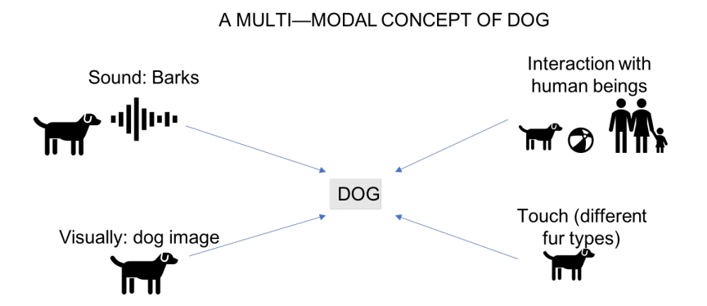
Concept of multimodality
Notes:
Described the concept of multimodality and they said Our world is, indeed, inherently multimodal. We, in fact, constantly rely on several multiple senses (e.g., audio, visual, touch) and combine their knowledge to make our decisions.
In our day-to-day learning experiences, we collect information using all of our five senses to be able to gather data to later use in our personal cognition experience.

Slide 7
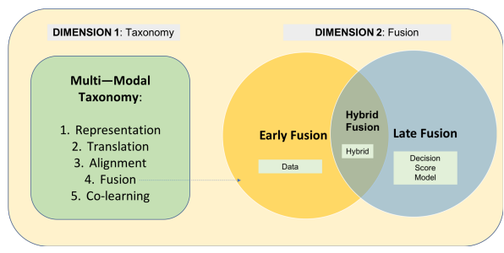
Introduce the definition of multimodality as a two dimensional concepts
Need of representing and summarizing in a proper way the input features
Capability of translating one modality to another
Need to identify the direct relationships between one or more sub-element parts of the same input data
Need of joining information in two or more modalities
Entails the need of transferring knowledge between the modalities used in the experimental settings.
These five types can be considered as sub-types of the three aforementioned fusion:
Such fusion happens when the multimodal input data is fused prior to the application of the AI model.
Fusion step takes place after the application of the AI algorithm.
Fusion takes place when the multimodal input data is fused both before and after the application of the relevant AI algorithm.
Data-level fusion: Modalities are fused before the learning process.
Decision-level fusion: Decision scores are firstly computed separately for each AI model applied.
Score-level fusion: Fusion mechanism happens at the level of the probabilistic output scores of neural networks
Hybrid-level fusion and model level fusion:
-Characteristics of the features- and decision-level fusion are merged.
-Fusion takes place during the training and learning procedure of the AI model.
Notes:
Words: addresses/concerns/refers
this research challenge entails the need of transferring knowledge between the modalities used in the experimental settings.
The second multimodality dimension we defined concentrates on the fusion process.
Example: Feature extraction before learning
Majority voting approaches
A single decision is then taken only after the fused scores have been produced. This is part of the late fusion-modality approach.

Slide 8
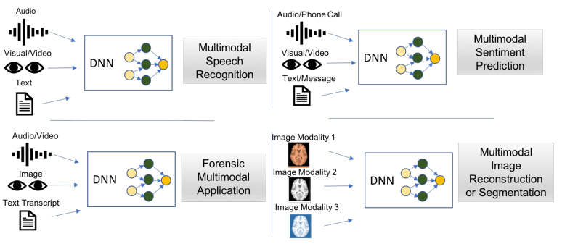
Multimodality Deep-Learning Applications
Notes:
Several multimodal DL architectures have been proposed . In this section, we will consider four fields of the application of multimodality to DL

Slide 9
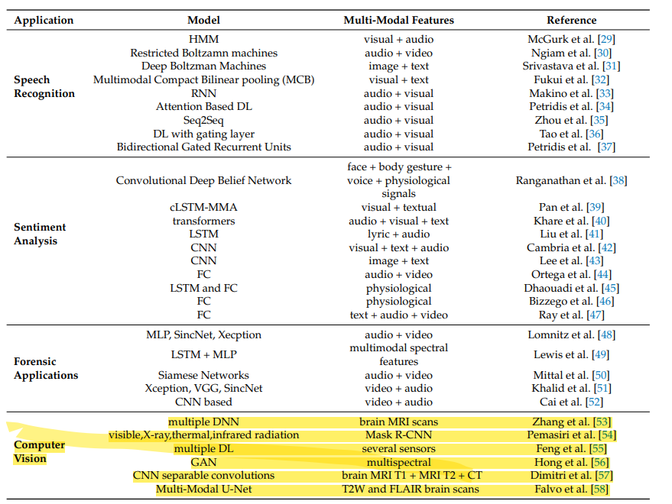

Slide 10
Jing Gao, Peng Li, Zhikui Chen, Jianing Zhang; A Survey on Deep Learning for Multimodal Data Fusion. Neural Comput 2020; 32 (5): 829–864. doi: https://doi.org/10.1162/neco_a_01273
Notes:
This provide useful information for multimodal data fusion using deep learning

Slide 11
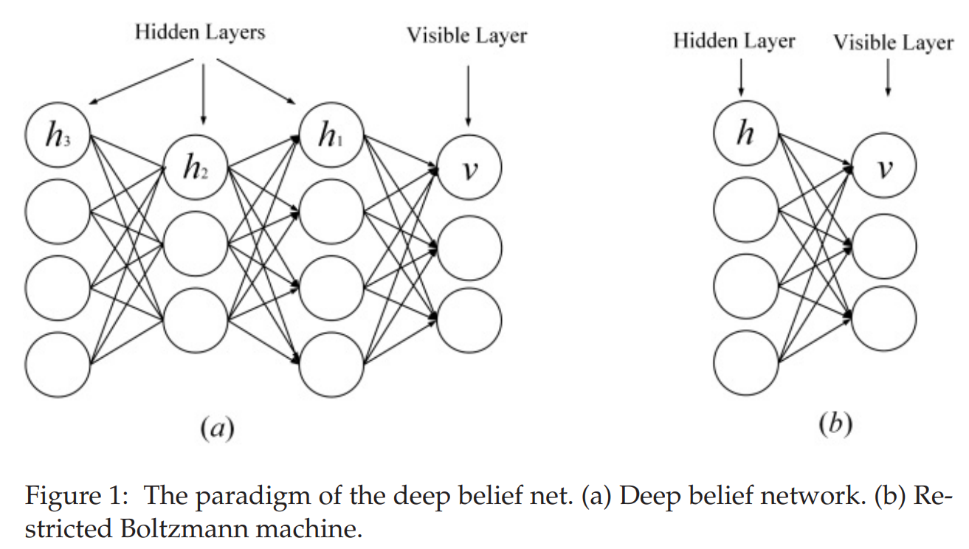
The Representative Deep Learning Architectures
The Deep Belief Net (DBN)
RBM is the basic block of the deep belief net (DBN)
It consists of a visible layer and a hidden layer;
Notes:
we introduce representative deep learning architectures of the multimodal data fusion deep learning models.
there are fully connected connections between units of the visible layer and units of the hidden layer and but no connections of units in the same layer.

Slide 12
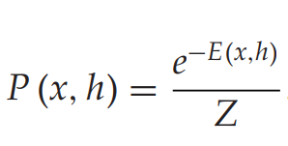
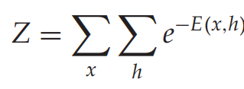
The Representative Deep Learning Architectures
The Deep Belief Net (DBN)
It uses the energy function to capture the probability distribution between visible units and hidden units in the following form,
With the normalizing function Z calculated as,
where x is the visible unit, h represents the hidden unit, and E () is the energy function.

Slide 13
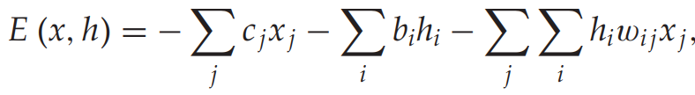
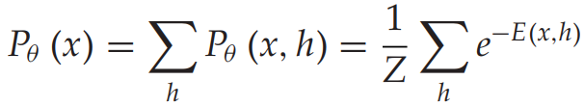
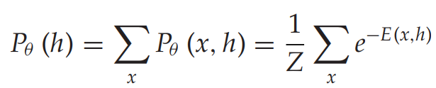
The energy function is expressed in the following,
where w_{ij} denotes the weight and c_{j} and b_{i} denote the RBM biases.
The visible and hidden marginal distributions of the RBM can be computed as follows:

Slide 14
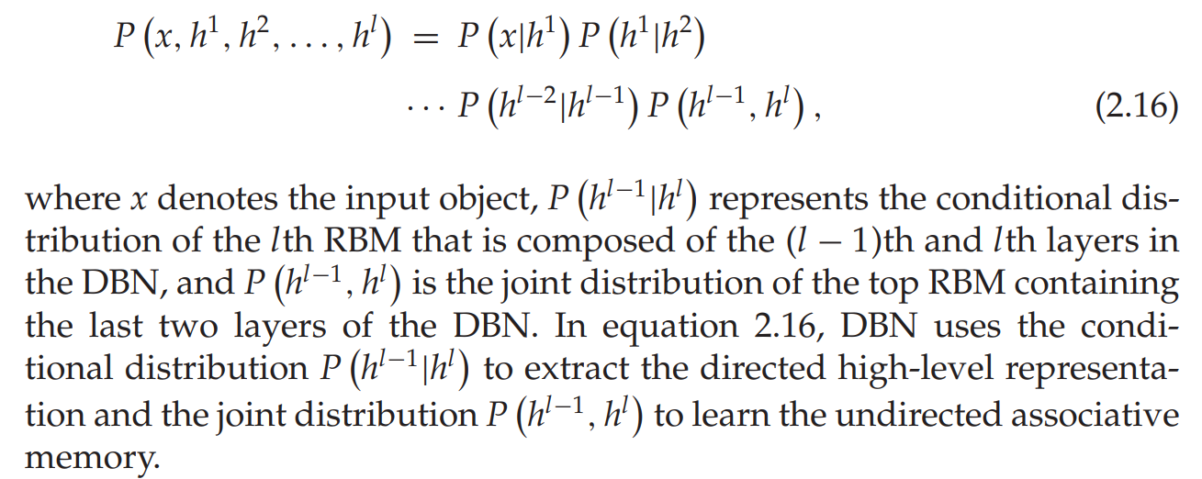
The DBN is constructed by stacking several RBMs
Based on a pretraining and fine-tuning training strategy.
In pretraining, each hidden layer is greedily modeled as an RBM trained in the unsupervised strategy.
Afterward, each hidden layer is further trained by the discriminative information of training labels in the supervised strategy.
A DBN with l hidden layers represents the complex correlation in the following form,
Notes:
To obtain conditional and joint distributions, DBN is trained by the unsupervised learning in a layer-wise manner. In other words, each hidden layer is modeled as an RBM. The output of the lower RBM is inputed to the upper one. In detail, the first hidden layer is modeled as an RBM that takes the training data as input, resulting in the empirical distribution of the first DBN hidden layer being approximated by the distribution captured by the RBM. Then the captured approximation distribution is fed to the RBM, that is, the second DBN hidden layer, to further capture the distribution in the training data in the same way. This process is repeated until the last hidden layer is trained.
After unsupervised learning, these parameters—the weights W and hidden biases b—are employed to initialize a deep discriminative neural network of the same architecture.
Then the deep discriminative model generally is further trained by the stochastic gradient descent algorithm to learn the discriminative knowledge in object labels.

Slide 15
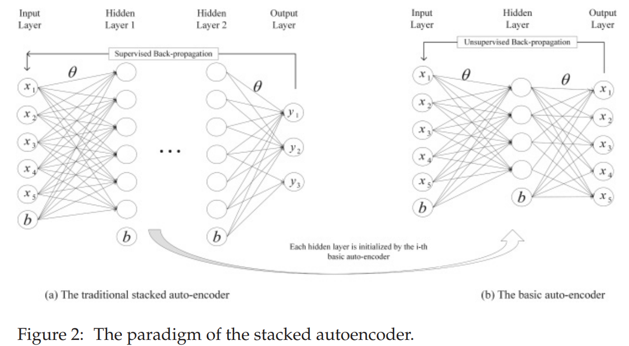
The Stacked Autoencoder (SAE)
A stacked autoencoder (SAE) is a typical deep learning model of the encoder-decoder architecture
An autoencoder learns two functions: an encoding function that transforms the input data, and a decoding function that recreates the input data from the encoded representation.
It can capture abstract features of the input by transforming the raw input into the intermediate representations.
SAE is stacked by several basic autoencoders.
A basic autoencoder consists of an input layer, a hidden layer, and an output layer.
The input layer obtains the raw signal, the intermediate hidden layer encodes the input into a compact hidden representation, and the output layer reconstructs the input signal.

Slide 16
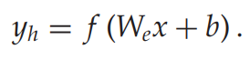
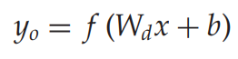
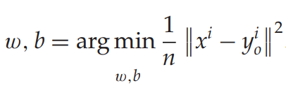
In particular, given the data set {x₁, x₂,..., x_{n}}, the basic autoencoder encodes the raw signal into the compact representation at the hidden layer as follows:
The basic autoencoder then decodes the intermediate representation using,
where y is the activation, W denotes the weight, and b represents the bias. f is the nonlinear function.
To make the autoencoder reconstruct the raw input, the parameters of the autoencoder are optimized by minimizing the average reconstruction error as follows:

Slide 17
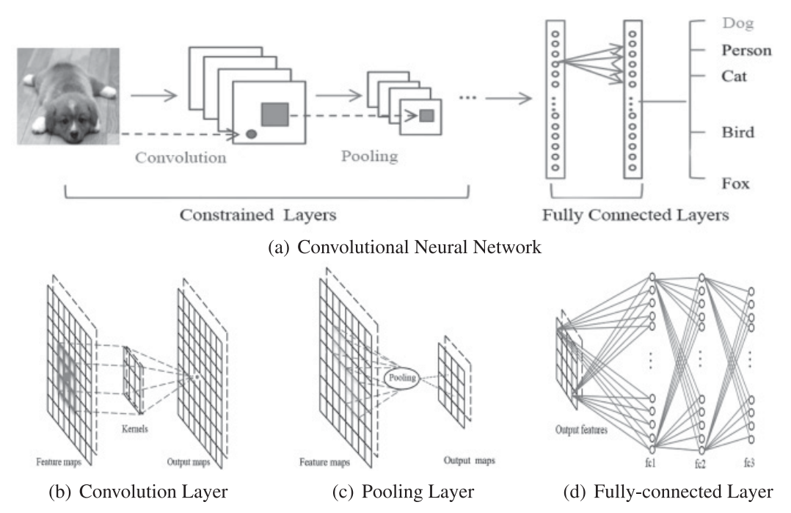
The Convolutional Neural Network (CNN)
A convolutional neural network includes the fully connected network and the constrained network that includes the convolutional and pooling layers.
The constrained network use the convolution and pooling operations to achieve the local receptive field and parameter reduction.
It considers the local topology of data
Notes:
DBN and SAE are fully connected neural networks. In these two networks, each neuron in the hidden layer connects to every neuron of the previous layer,
a topology that produces a great number of connections. To train the weights of these connections, the fully connected neural network requires a great number of training objects to avoid overfitting and underfitting,
which is computationally intensive. Also, the fully connected topology does not consider the location information of features contained between neurons.
Thus, the fully connected deep neural network—DBN, SAE, and their variants—cannot deal with the high-dimensional data, especially large image and large audio data.

Slide 18
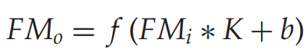
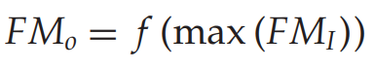
Given the training objects {x1, x2,... xN} with labels { y1, y2,... yN }, the CNN uses the convolutional layer to transfer input pattern maps to output feature maps as follows:
where ∗ represents the convolution operation and FM_{o} and FM_{i} are the output and input, respectively. K denotes the convolutional kernel.
The convolutional layer uses the convolutional operation to force the neuron to perceive a local receptive field of input feature maps.
By using this field, the CNN can greatly decrease network parameters.
After each convolutional layer, CNN uses the pooling layer to further deal with the output feature maps.
Max pooling layer is the representative layer that models input maps, as follows,
where the max() captures the obvious pattern in its receptive field.

Slide 19
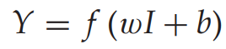
Finally, CNN uses the fully connected layers to map the hidden features to its corresponding class with the following function,
where w and b are the network parameters.

Slide 20
The Recurrent Neural Network (RNN)
A recurrent neural network is a type of neural computing architecture that deals with serial data
It not only maps the input patterns to the output results but also transfers the hidden states to the outputs by employing the connections between the hidden units.
By using these hidden connections, the RNN models temporal dependency, which results in the sharing of parameters between objects along the time dimension.
In forward-pass computing, RNN takes both the input and the hidden state.
In backpropagation computing, it uses the backpropagation-through-time algorithm to backpropagate the loss through the time direction

Slide 21
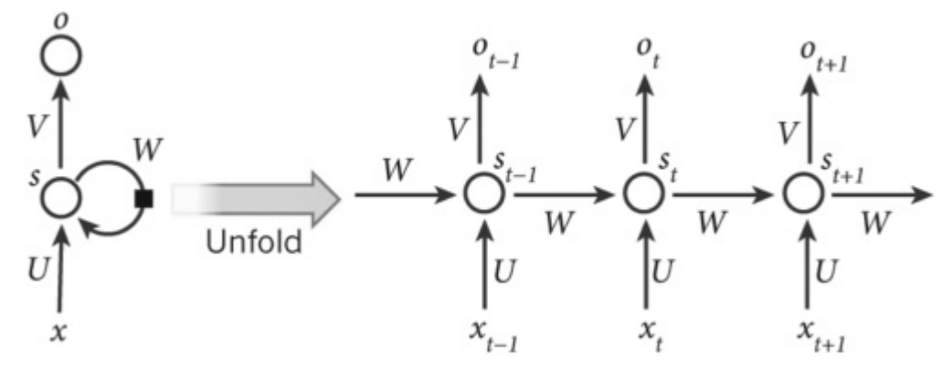
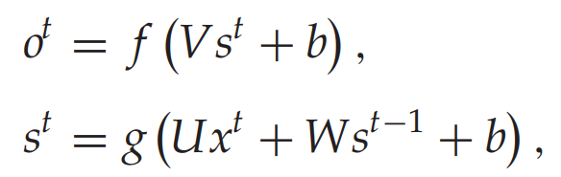
The Recurrent Neural Network (RNN)
Given a training object (x¹,..., x^{t−1}, x^{t} , x^{t+1},..., x^{n}) with the label (y¹,..., y^{t−1}, y^{t} , y^{t+1},..., y^{n}), the mapping of the RNN is expressed as follows:
where f and g are nonlinear functions, b is the bias, and V, U, and W represent the weight parameters. Specifically, the matrix V weights activations of hidden nodes, the matrix U encodes the current inputs, and the matrix W transfers the previous hidden state that contains the temporal dependency
Notes:
To fit the sequential training object well, RNN uses the backpropagation through-time algorithm to train its parameters (Hermans & Schrauwen, 2013; Zheng et al., 2015).
In particular, it backpropagates the loss along the time direction.

Slide 22
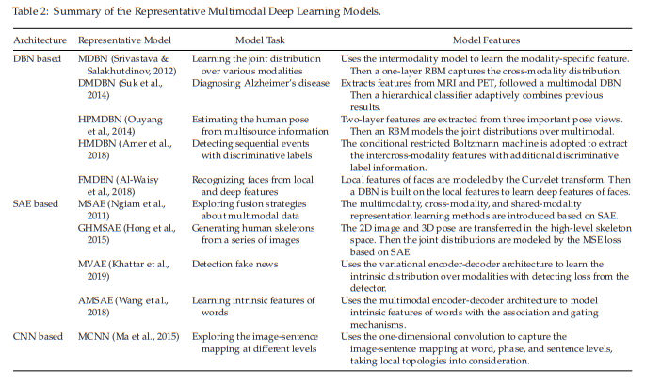
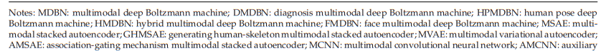
Deep Learning for Multimodal Data Fusion
Notes:
we review the most representative multimodal data fusion deep learning models from the perspectives of the model task, model framework, and evaluating data set. They are grouped into four categories based on the deep learning architecture that is used. The representative multimodal deep learning models are summarized in Table

Slide 23
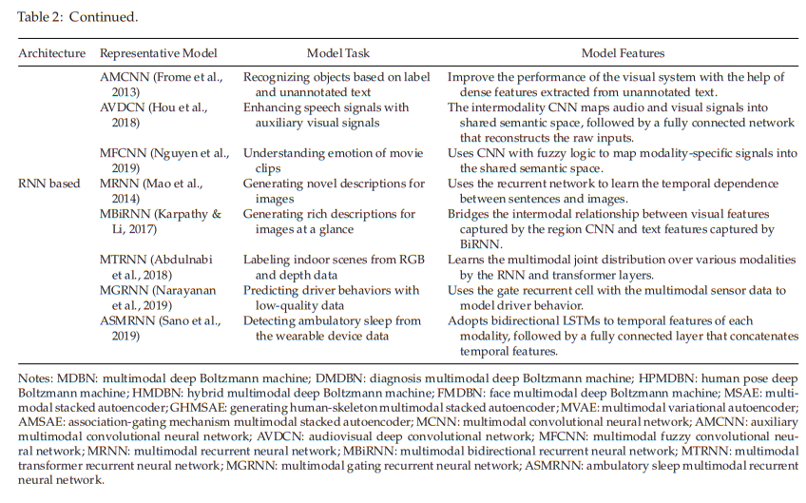

Slide 24
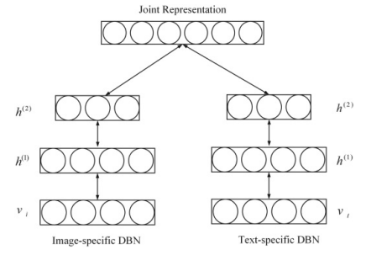
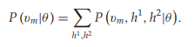
MDBN: Multimodal Deep Belief Net (DBN-based)
Two modality-specific models are used to transfer the raw-level, high-dimensional image and text into the corresponding high-abstract representations
Each modality is with a different statistical distribution.
The one-layer RBM is used to capture the joint representation by feeding the concatenated vector of each learned representation with the following form:
Notes:
Two modality-specific models are used to transfer the raw-level, high-dimensional image and text into the corresponding high-abstract representations, respectively,
since the joint correlations are implicit in the raw-level, high-dimensional inputs.->> Modality specific features
Also, each modality is with a different statistical distribution. After obtaining each high-abstract representation of each modality, a deep Boltzmann model is used to learn the joint distribution over each modality, as shown in Figure 5. In detail, a
two-layer deep belief model in which the gaussian RBM and the binary RBM are the first and second hidden layers, respectively, is used to model the image modality,
as is a two-layer DBN that is a combination of a replicated softmax layer and an RBM layer to learn text features. Then the one-layer RBM is used to capture the joint
representation by feeding the concatenated vector of each learned representation with the following form: ->Cross-modality distribution

Slide 25
DMDBN: Diagnosis Multimodal Deep belief Net
Diagnosing Alzheimer’s disease
A DBN is used to learn the deep representations of each modality by transferring the domain-specific representation to the hierarchical abstract representation.
A one-layer RBM is built on the concatenated vector that is the linear combination of the hierarchical abstract representations from each modality.
It is used to learn the multimodal representation by constructing the joint distribution over the different multimodal features.

Slide 26
HPDBN: Human Pose Deep belief Net
Estimating human pose from multisource information.
Two layer RBM-extract two-layer features from three features of the pictorial structure model
Then an RBM models the joint distribution over multimodal.
HMDBN: Hybrid Multimodal Deep Belief Net
Detecting sequential events with discriminative labels
The conditional RBM is adopted to extract the intermodality and cross-modality features with additional discriminative label information.
FMDBN: Face Multimodal Deep Belief Net
Recognizing faces from local and deep features
Local features of faces are modeled by the Curvelet transform.
A DBN is built on the local features to learn deep features
Notes:
A DBN is built on the local features to learn deep features which can merge the advantages of the local and deep features
Those DBN-based multimodal models use the probabilistic graphical network to transfer the modality-specific representations into
the semantic features in the shared space. Then the joint distribution over modalities is modeled based on the features of the shared space.
Those DBN-based multimodal models are more flexible and robust in unsupervised, semisupervised, and supervised learning strategies.
They are well suited to capture informative features of input data. However, they neglect the spatial and temporal topologies of the multimodal data.

Slide 27
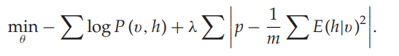
Stacked Autoencoder-Based Multimodal Data Fusion
MSAE: Multimodal Stack Autoencoder
Exploring fusion strategies about multimedia data
Three learning scenarios are introduced—
multiple-modality,
cross-modality, and
shared-modality learning
Sparse coding is used by penalizing the loss function with the sparse constraints of the following form:
Notes:
is the most representative deep learning model based on the stacked autoencoder (SAE) for multimodal data fusion. This deep learning model aims to address two data-fusion problems:
cross-modality and shared-modality representational learning. The former aims to capture better single-modality representations, leveraging knowledge from other modalities,
while the latter learns the complex correlation between modalities at a midlevel. To achieve these, three learning scenarios—multiple-modality, cross-modality, and shared-modality
learning—are designed, as depicted in Table 3 and Figure 6. Furthermore, in each scenario, to learn better representations, sparse coding is used by penalizing the loss function with the
sparse constraints of the following form:

Slide 28
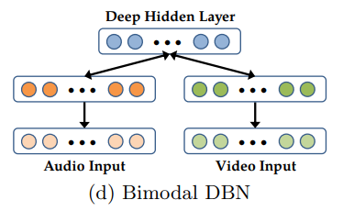
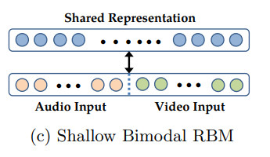
RBM Pretraining Models (MSAE cont.)
In a multiple-modality learning scenario, train a RBM over the concatenated audio and video data.
Since the correlations between the audio and video data are highly non-linear, it is hard for a RBM to learn these correlations and form multimodal representations.
The bimodal deep belief network (DBN) model is trained in a greedy layer-wise fashion over the pre-trained layers for each modality
By representing the data through learned first layer representations, it can be easier for the model to learn higher-order correlations across modalities.
Notes:
train a RBM over the concatenated audio and video data (Figure 2c). While this approach jointly models the distribution of the audio and video data, it is
limited as a shallow model. In particular, since the correlations between the audio and video data are highly non-linear, it is to capture correlation across the modalities.
lations and form multimodal representations. In practice, we found that learning a shallow bimodal RBM results in hidden units that have strong connections to
variables from individual modality but few units that connect across the modalities.
Motivated by this,…….. which shows better performance
However, there are still two issues with the above multimodal models. First, there is no explicit objective for the models to discover correlations across the modalities;
it is possible for the model to find representations such that some hidden units are tuned only for audio while others are tuned only for video. Second, the models are
clumsy to use in a cross modality learning setting where only one modality is present during supervised training and testing.

Slide 29
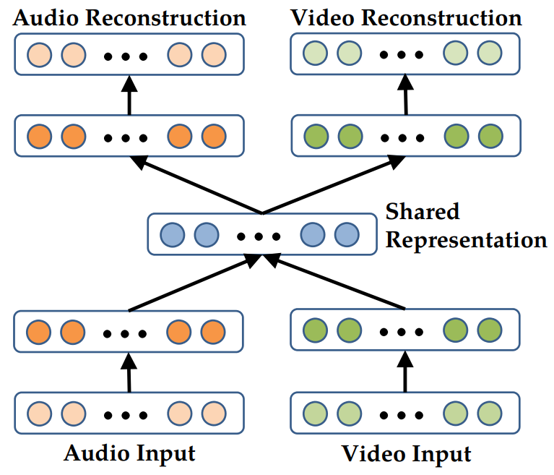
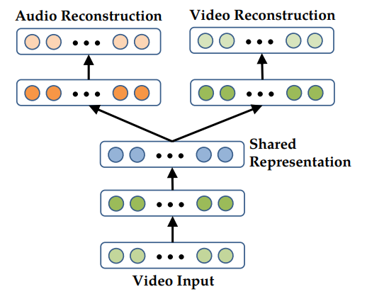
Deep Autoencoder Models (MSAE cont.)
In the cross-modality learning scenario, first consider the cross modality learning setting where both modalities are present during feature learning but only one of them is fed into the model in the supervised training and testing.
The deep autoencoder is trained to reconstruct both modalities when given only video data and thus discovers correlations across the modalities.
In the shared-modality representation, a modality-specific deep stacked multimodal autoencoder is introduced to explore the joint representation between modalities, especially, when one modality is absent.
The training data set that is enlarged by replacing one of modalities with zeros is fed into the model in feature learning.
Deep cross modality
Deep shared modality
Notes:
The middle layer can be used as the new feature representation.
This can model the cross-modality relationship well.
…..
Thus, one-third of the training data has only video for input, while another one-third of the data has only audio, and the last one-third of the data has both audio and video.

Slide 30
GHMSAE: Generating Human-skeleton Multimodal Stacked Autoencoder
Generating human skeletons from a series of images
The 2D image and 3D pose are transferred in the high-level skeleton space.
Then the joint distributions are modeled by the MSE loss based on SAE
MVAE: Multimodal Variational Autoencoder
Detecting fake news
Uses VAE architecture to learn the intrinsic distribution over modalities with detecting loss from the detector
AMSAE: Association-gating mechanism Multimodal Stacked Autoencoder
Learning intrinsic features of words
Uses multimodal encoder-decoder architecture to model intrinsic features of words with the association and gating mechanisms
Notes:
The SAE-based multimodal models use the encoder-decoder architecture to extract the intrinsic intermodality feature and cross-modality feature
by the reconstruction method in an unsupervised manner. Since they are based on SAE, which is a fully connected model, a lot of parameters
need to be trained. Also, they neglect the spatial and temporal topologies in the multimodal data.

Slide 31
Convolutional Neural Network–Based Multimodal Data Fusion
MCNN: Multimodal Convolution Neural Network
Exploring the image-sentence mapping at different levels
Uses the one-dimensional convolution to capture the image-sentence mapping at
Word, phrase, and sentence levels, taking local topologies into consideration
AMCNN: Auxiliary Multimodal Convolution Neural Network
Recognizing objects based on label and unannotated text
This network is composed of the language submodel and the visual submodel.
The language submodel transfers text information into a dense representation of the semantic space.
The visual submodel captures visual features
To model the semantic relationship between images and texts, the language and visual submodels are combined by a linear projection layer.
Notes:
The CNN-based multimodal models can learn the local multimodal feature between modalities by using the local field and pooling operation. They explicitly model the spatial topologies of the multimodal data.
And they are not fully connected models in which the number of parameters is greatly reduced.

Slide 32
To train this visual-semantic multimodal model, a novel loss function is proposed by combining the dot-product similarity and hinge rank loss.
AVDCN: Audiovisual Deep Convolution Network
Enhancing speech signals with auxiliary visual signals
CNN is used to capture intermodality features in audio and visual signals.
Then a fully connected network models the joint distribution by reconstructing the raw inputs.
MFCNN: Multimodal fuzzy Convolution Neural Network
Understanding emotion of movies clips
Fuzzy logic combined with CNN is used to model intermodality features from audio, visual, and text modalities.
Notes:
The CNN-based multimodal models can learn the local multimodal feature between modalities by using the local field and pooling operation. They explicitly model the spatial topologies of the multimodal data.
And they are not fully connected models in which the number of parameters is greatly reduced.

Slide 33
Recurrent Neural Network–Based Multimodal Data Fusion
MRNN: Multimodal Recurrent Neural Network
Generating novel descriptions for images
The multimodal recurrent neural model (MRNN) learns a joint distribution over the semantic space, based on the given words and image. When an image comes, it generates the sentences word by word, based on the captured joint distribution.
It consists of a language subnetwork, a vision subnetwork, and a multimodal subnetwork
Notes:
Uses the recurrent network to learn the temporal dependence between sentences and images

Slide 34
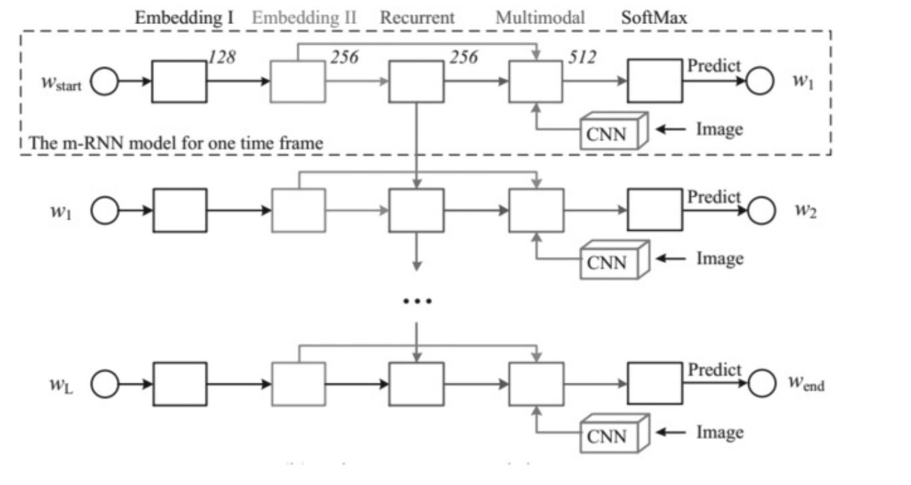
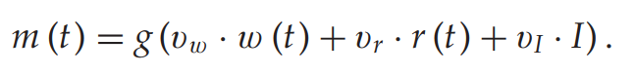
The language subnetwork is composed of a two-layer word embedding part that captures an effective task-specific representation and a one-layer recurrent neural part that models the temporal dependency of the sentence.
The vision subnetwork encodes the high-dimensional image into a compact representation.
The multimodal subnetwork is a hidden network that models the joint semantic distribution over the learned language and vision representation, with the following form:
Notes:
The language subnetwork is composed of a two-layer word embedding part that captures an effective task-specific representation and a one-layer recurrent neural part that models the temporal dependency of the sentence.
The vision subnetwork is essentially a deep convolutional neural network such as Alexnet, Resnet, or Inception, which encodes the high-dimensional image into a compact representation.
Furthermore, to train the multimodal recurrent neural model, Mao et al. (2014) use an average log-likelihood loss function based on a standard language evaluation method. After that, the backpropagation algorithm is used to update parameters of the proposed model.
It addresses the limitation of previous work that cannot generate novel image captions, since previous work retrieves the corresponding caption in the sentence database based on the learned image-text mappings.

Slide 35
MBiRNN: Multimodal Bidirectional RNN
Generating rich descriptions for image at a glance
Bridges the intermodal relationships between visual features captured by the region CNN and text features captured by BiRNN
A visual-semantic embedding model is designed to generate the multimodal training data set.
Then a multimodal RNN is trained on this data set to generate the rich descriptions of images.
MTRNN: Multimodal Transformer RNN
Labeling indoor scenes from RGB and depth data
Learns the multimodal joint distribution over various modalities by the RNN and transformer layers
MGRNN: Multimodal gating RNN
Predicting driver behaviors with low-quality data
Uses the gate recurrent cell with the multimodal sensor data to model driver behavior
Notes:
a twofold scheme is proposed. First, a visual-semantic embedding model is designed to generate the multimodal training data set. Then a multimodal RNN is trained on this data set to generate the rich descriptions of images.
multimodal RNN to label indoor scenes in which the intermodality feature and cross-modality feature are learned by the RNN and transform layers

Slide 36
ASMRNN: Ambulatory sleep multimodal RNN
Detecting ambulatory sleep from the wearable device data
Adopts bidirectional LSTMs to temporal features of each modality, followed by a fully connected layer that concatenates temporal features
Notes:
The RNN-based multimodal models are able to analyze the temporal dependency hidden in the multimodal data.
They use the backpropagation-through-time algorithm to train parameters. Due to the computation in the hidden state transfer, it is difficult to parallelize on the high-performance devices.

Slide 37
Future Directions
Summarized several multimodal data fusion deep learning models in four groups: DBN, SAE, CNN, and RNN.
These pioneering models have made some progress.
Still in the preliminary stage
Future research possibilities of deep learning on the fusion feature learning of multimodal data are to
Design new learning frameworks with more powerful computing architectures.
Combine the current compression strategy to design new compression methods of multimodal deep learning.
Combine of deep learning and semantic fusion strategies may be a way to solve the challenges posed by the exploration of multimodal data, especially for cross and intermodality representation.
Design of online and incremental multimodal deep learning models for data fusion must be addressed.
Address a deep learning model for low-quality multimodal data
Notes:
In this survey, we summarized several multimodal data fusion deep learning models, all built on the current representative deep learning architectures: DBN, SAE, CNN, and RNN.
We summarize the models in four groups of multimodal data deep learning models based on DBN, SAE, CNN, and RNN. These pioneering models have made some progress;
however, the models are still in the preliminary stage, so there are still challenges
In addition, the compression of free parameters, an effective way to enhance training efficiency in deep learning for single-modality data feature learning has made great progress.
Thus, how to combine the current compression strategy to design new compression methods of multimodal deep learning is also a potential research direction.
Most existing deep learning models for multimodal data fusion first use a deep model to capture the private features from each modality, transforming the modality-specific raw representation
to a high-abstraction representation in a certain global space. Then these high abstraction representations are further concatenated into a vector that represents the global representation of
the multimodal. Finally, a deep model is used to model high-abstract representations from the concatenated vectors.
However, by using this method, the multimodal deep learning models cannot capture the fully semantic knowledge of the multimodal data, .. Lose cross-modality information. Also, the intermodality representations are concatenated in a linear fashion that cannot fit the complex relationships over multiple modalities.
Multimodal data are collected from dynamic environments, indicating that the data are uncertain. That is, these data are dynamic, which means that the distribution of data is not unchanged.
Online learning and incremental learning are the representative real-time strategies that learn the new knowledge of the new data without much loss of historical knowledge.
the multimodal data are low quality and contain noise, incomplete data, and outliers.
Currently, several deep learning models are focusing only on single-modality noisy data.
With the explosion of low-quality multimodal data, a deep learning model for low-quality multimodal data needs to be addressed.

Slide 38
ImageBind: One Embedding Space To Bind Them All
Girdhar, R., El-Nouby, A., Liu, Z., Singh, M., Alwala, K.V., Joulin, A., & Misra, I. (2023). ArXiv, abs/2305.05665.

Slide 39
ImageBind
An approach to learn a joint embedding across six different modalities - images, text, audio, depth, thermal, and IMU data.
The ‘Binding’ property of images offers many sources of supervision to learn visual features, by aligning them with any of the sensory experiences associated with images.
Requires acquiring all types and combinations of paired data with the same set of images
Notes:
A single image can bind together many experiences – an image of a beach can remind us of the sound of waves, the texture of the sand, a breeze, or even inspire a poem.
This ‘binding’ property of images offers many sources of supervision to learn visual features, by aligning them with any of the sensory experiences associated with images.
Ideally, for a single joint embedding space, visual features should be learned by aligning to all of these sensors. However, this requires acquiring all types and combinations of paired data
with the same set of images, which is infeasible.
Recently, many methods learn image features aligned with text , audio, etc. These methods use a single pair of modalities or, at best, a few visual modalities.
However, the final embeddings are limited to the pairs of modalities used for training. Thus, video-audio embeddings cannot directly be used for image-text tasks and vice versa.
A major obstacle in learning a true joint embedding is the absence of large quantities of multimodal data where all modalities are present together.
Their goal is to learn a single joint embedding space for all modalities by using images to bind them together.

Slide 40
ImageBind
Learns a single shared representation space by leveraging multiple types of image-paired data.
Does not need datasets where all modalities co-occur with each other.
It leverages the binding property of images
just aligning each modality’s embedding to image embeddings leads to an emergent alignment across all of the modalities.
IMAGEBIND leverages web-scale (image, text) paired data and combines it with naturally occurring paired data
such as (video, audio), (image, depth) etc. to learn a single joint embedding space.
Enabling zero-shot recognition capabilities
It can be initialized with large-scale vision-language models such as CLIP
Notes:
learns a single shared representation space by leveraging multiple types of image-paired data. It does not need datasets where all modalities co-occur with each other.
Instead, we leverage the binding property of images and we show that just aligning each modality’s embedding to image embeddings leads to an emergent alignment across all of the modalities.
In practice, IMAGEBIND leverages web-scale (image, text) paired data and combines it with naturally occurring paired data such as (video, audio), (image, depth) etc. to learn a single joint embedding space.
This allows IMAGEBIND to implicitly align the text embeddings to other modalities such as audio, depth etc., enabling zero-shot recognition capabilities on that modality without explicit semantic or textual pairing.

Slide 41
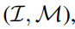
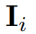
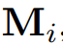
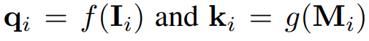
Binding modalities with images
IMAGEBIND uses pairs of modalities,
where represents images and is another modality, to learn a single joint embedding.
Use large-scale web datasets with (image, text) pairings that span a wide range of semantic concepts.
Additionally, we use the natural, self-supervised pairing of other modalities – audio, depth, thermal, and Intertial Measurement Unit (IMU) – with images.
Consider the pair of modalities with aligned observations.
Given an image and its corresponding observation in the other modality , we encode them into normalized embeddings:
where f, g are deep networks.

Slide 42
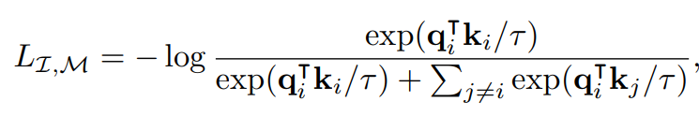
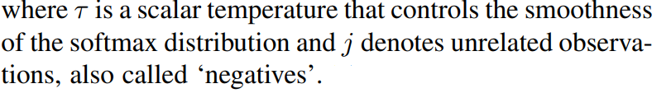
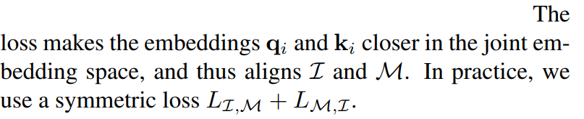
Binding modalities with images
The embedding and encoders are optimized using InfoNCE loss:

Slide 43
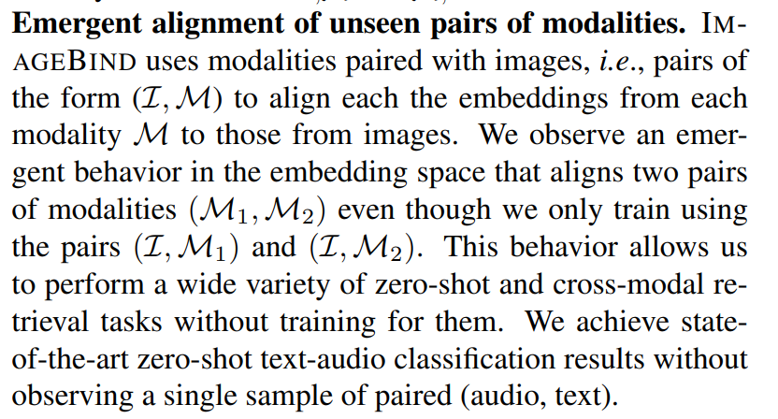

Slide 44
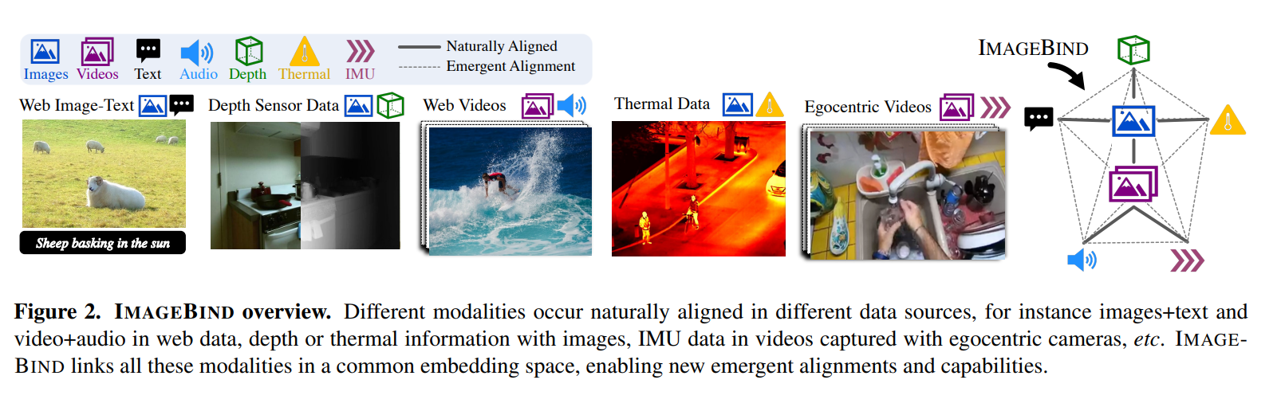
Notes:
We align each modality’s embedding to image embeddings, such as text to image using web data and IMU to video using video data captured from egocentric cameras with IMU.
We show that the resulting embedding space has a powerful emergent zero-shot behavior that automatically associates pairs of modalities without seeing any training data for that specific pair.

Slide 45
Implementation: Encoding modalities
Uses a Transformer architecture (ViT) for all the modality encoders
For encoding audio, converted into spectrograms.
As the spectrogram is also a 2D signal like an image, we use a ViT
ImageBind treats thermal images and depth images as one-channel images and also use ViT to encode them
IMU reading are projected using a 1D convolution with a kernel size of 8 and encoded using a Transformer.
Finally, we follow the text encoder design from CLIP
Used separate encoders for images, text, audio, thermal images, depth images, and IMU.
Added a modality-specific linear projection head on each encoder to obtain a fixed size d dimensional embedding
Notes:
convert depth into disparity maps for scale invariance (one channel image).

Slide 46
Experiments
ImageBind dataset:
Emergent zero-shot vs zero-shot
Audioset dataset-> (video, audio)
Sun RGBD dataset-> (image, depth)
LLVIP dataset-> (image, thermal)
Ego4D dataset-> (video, IMU)
Large-scale web data-> (image, text)
CLIP-> (image, text)
AudioCLIP->(audio, text)
ImageBind-> (image, text), (image, audio)
termed as emergent zero shot classification
IMAGEBIND outperforms prior methods on zero-shot retrieval and has comparable performance on the classification task.
Notes:
We use IMAGEBIND on six modalities - image/video, text, audio, depth, thermal images, and IMU.
Methods such as CLIP , AudioCLIP etc. train with modality pairs, (image, text) and (audio, text), to demonstrate zero-shot classification using text-prompts for the same modality.
In contrast, IMAGEBIND binds modalities together using only image-paired data. Thus, just by training on (image, text) and (image, audio), IMAGEBIND can perform zero-shot classification of audio using text prompts.
As we do not directly train for this ability, we term it emergent zero-shot classification to distinguish it from methods that specifically train using paired text-supervision for all modalities

Slide 47
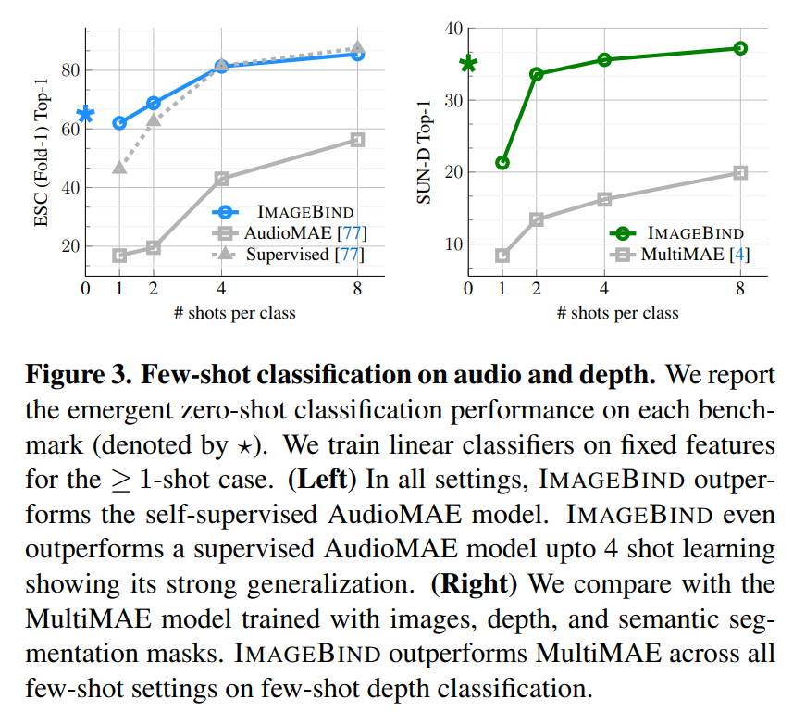
Experiments
Evaluation the label-efficiency of IMAGEBIND by evaluating on few-shot classification.
Use the audio and depth encoders from IMAGEBIND and evaluate them on audio and depth classification respectively
Both baselines use the same capacity ViT-B audio encoder as IMAGEBIND.
Notes:
We use the audio and depth encoders from IMAGEBIND and evaluate them on audio and depth classification respectively

Slide 48
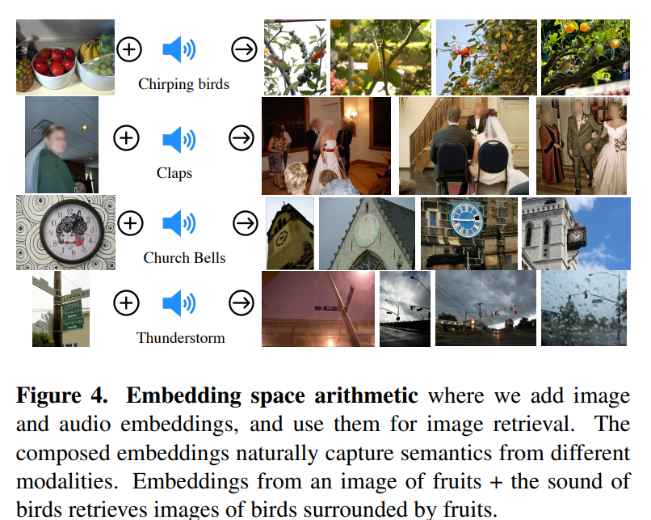
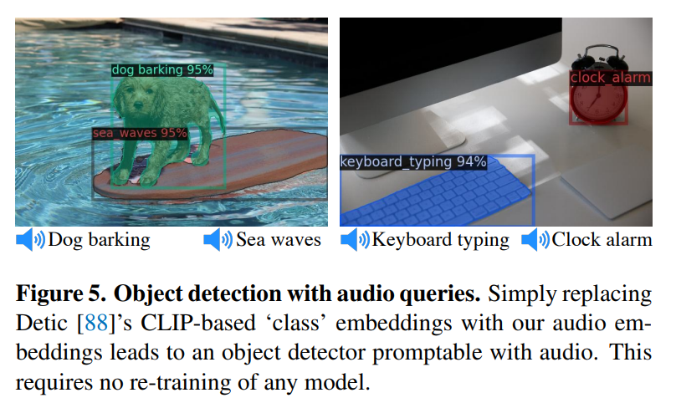
Analysis and Application
ImageBind’s embedding can be used to compose information across modalities.
Without re-training, we can ‘upgrade’ existing vision models that use CLIP embeddings to use IMAGEBIND embeddings from other modalities such as audio

Slide 49
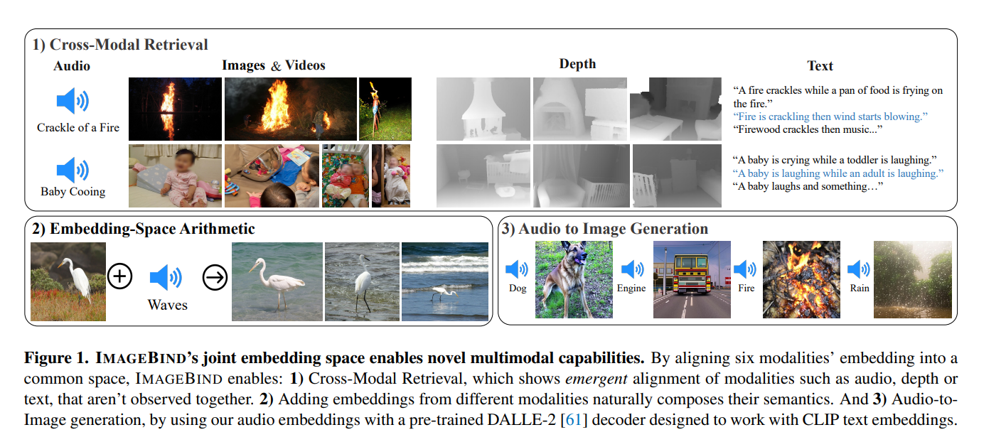
Notes:
IMAGEBIND’s joint embeddings can be used for a wide variety of compositional tasks as illustrated in Figure 1, including cross-modal retrieval, combining embeddings via arithmetic, detecting audio sources in images, and generating images given audio input.

Slide 50
----------------------------------------→

